Slide 1
VISUAL C#.NET session 4
Instructor: Edwin oduor

Slide 2

Quote of the day

Slide 3
Lesson objectives
For Loop
While Loop
While Loop flow Chart
Do While Loop
Do While Loop Flow Chart

Slide 4
Lesson pre-requisites
In order to take full advantage of this section you need to have the following;
Computer with Visual Studio Installed.
Stable Network Connection.

Slide 5
Training methods and extra readings
TRAINING METHODS FOR THIS LESSON
EXTRA READINGS
Lecturing Method – This is the main method of training to be adopted in this lesson with illustrations and practical coding examples.
Discussion Method - This method will be adopted periodically whereby learning will be derived principally from the students brainstorming together, rather than from the trainer. Three main types of discussions will be used:
Directed discussion
Developmental discussion
Problem-Solving discussion
Home and Learn C#

Slide 6
LOOPS

Slide 7
What is a LOOP?

Slide 8
To loop is to go round and round until the end condition is met. There are some instances as a developer one will want to execute a certain line of code over and over the code should stop being executed when the end condition is met.

Slide 9
TYPES OF LOOPS

Slide 10
1. For loop
2. Do loop
3. While loop

Slide 11
For loop
Below is a syntax of the For Loop
for (init; condition; increment) {
statement(s);
}
init – This is the starting point of the loop
Condition – the body of the loop is executed if the condition is true and if the condition is false, then it’s not going to be executed.
Increment – Once the body of the loop has executed, the incremental value will be able to increase the value based on what has been indicated.

Slide 12
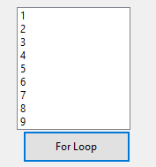
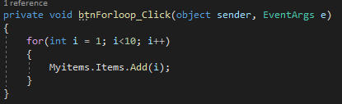
For loop code
The above code will display numbers 1 to 9 in a list box named “Myitems”

Slide 13
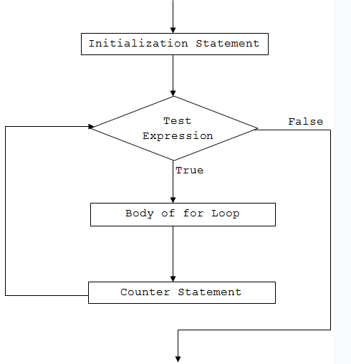
For loop flow chart

Slide 14
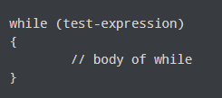
while loop
How the while loop works – when the code is run the test expression is checked if condition is true then the body of while loop is executed, goes back to the test expression checks the expression if the expression is false then loops out of the loop.

Slide 15
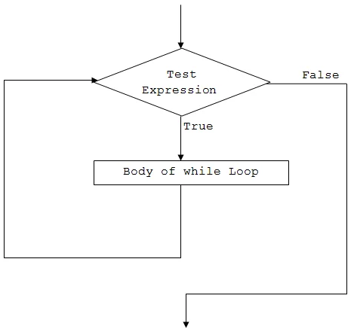
while loop flow chart

Slide 16

Do while loop
The Do while loop is similar to the while loop, the difference is that for while loop the expression or condition is checked first then the body of the loop is executed, while the Do while loop the body is executed first then expression checked.
The body of the Do while loop is executed first, then the expression is checked, if it’s true then, the body is going to be executed, until when the condition is false then its going to loop out of the loop.

Slide 17
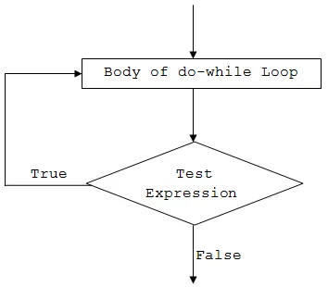
Do while loop flow chart

